Slide 1
Parts of Computer Hardware Lab 1
Information & Communication Technology
Department of Computer Science
Sukkur IBA University

Slide 2
Parts of Computer Hardware
Input
Devices
STORAGE DEVICES
(Hard Disk, CD Drive, DVD Drive, Floppy Drive etc.)
BUS
Microprocessor
Extended Slots
Power
Supply
BUS
Ports
Output
Devices
BUS
BUS
BUS
Memory Unit (RAM, ROM, Cache)

Slide 3
Motherboard
A motherboard sometimes called the “Mobo” is the main circuit board found in computers and other advanced electronic devices.
ATX (Advanced Technology eXtended) is a motherboard and power supply configuration specification developed by Intel in 1995 to improve on previous de facto standards like the AT design.

Slide 4
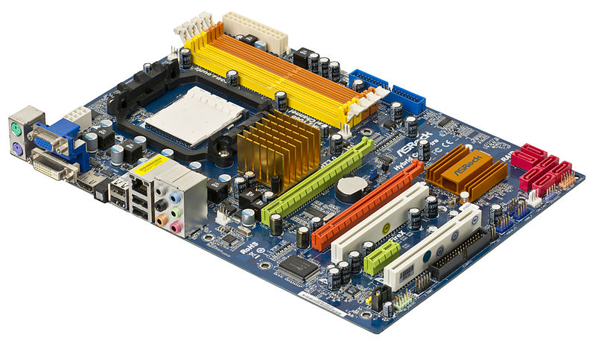
Basic ATX Motherboard
Notes:
ATX (Advanced Technology eXtended)

Slide 5
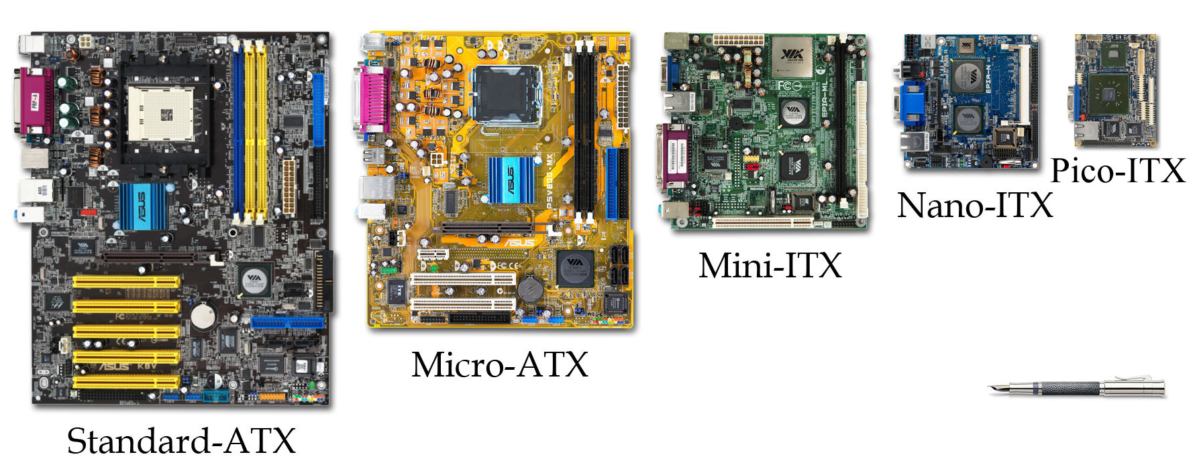
Variations of Motherboards
Notes:
ATX (Advanced Technology eXtended)
ITX Information Technology eXtended -

Slide 6
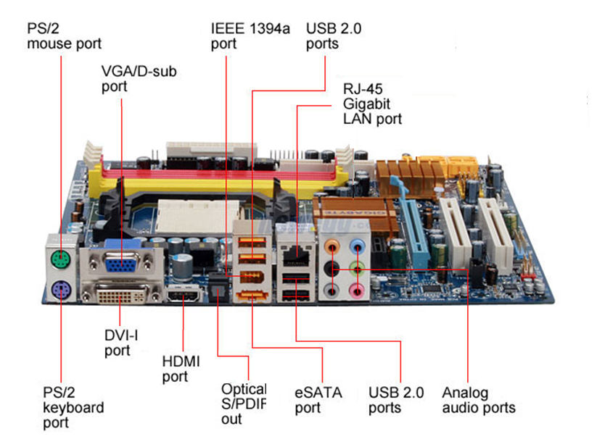
Notes:
PS2=Personal System/2 (1987)
VGA=Video Graphics Array
D-Sub=D SUBminiature
eSATA=External Serial Advanced Technology Attachment
ATA=Advanced Technology Attachment
SATA=Serial Advanced Technology Attachment
S/PDIF=(Sony/Philips Digital InterFace) A serial interface for transferring digital audio from CD and DVD players to amplifiers and TVs. S/PDIF is typically used to transmit PCM and Dolby Digital 5.1
RJ45=Registered jack-45
IEEE=Institute of Electrical and Electronics Engineers (High Performance Serial Bus, is an electronics standard for connecting devices to your personal computer. ... A simple common plug-in serial connector on the back of your computer and on many different types of peripheral devices.)

Slide 7
Power Supply Units
A power supply unit (PSU) converts AC power to low-voltage DC power for the internal components of a computer
PSU’s are usually mounted in the back of the computer case
The computer’s PSU powers every device located inside the case using a series of cables and plugs

Slide 8
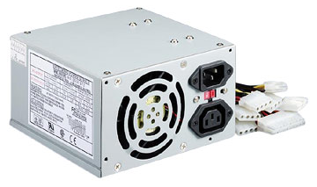
Power Supply
A computer power supply has a number of functions:
Converts Alternating current (AC) Direct current (DC)
Transforms mains voltage (240 Volts) to the voltages required by the computer. The main voltages are:
12 volts for the disk drives as they have motors
3.3 and 5 volts for the circuit boards in the computer

Slide 9
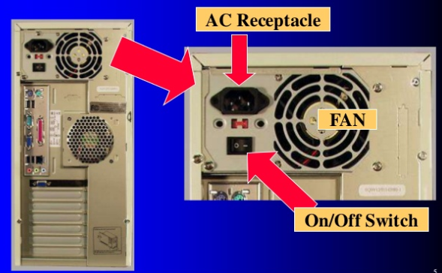
Power Supply

Slide 10
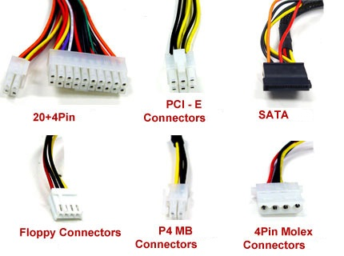
Power Supply Connectors

Slide 11
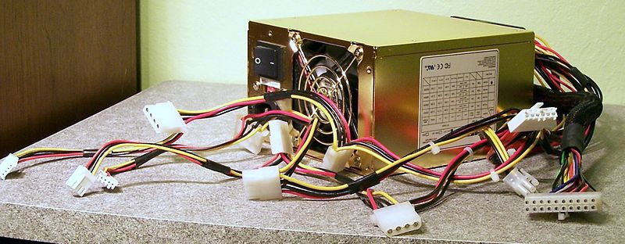
PSU Cables
Some cables plug into the motherboard, others plug into the hard drive or video card.
Notes:
4 Pin Peripheral Power Connector “molex connector”

Slide 12
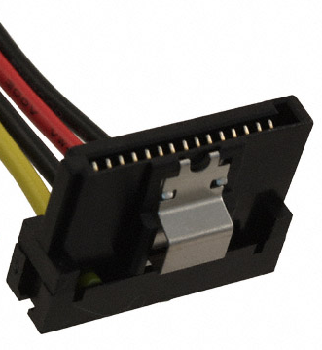
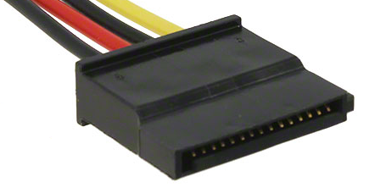
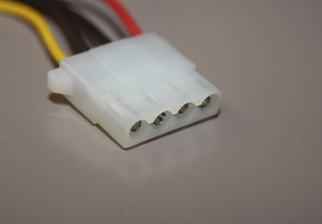
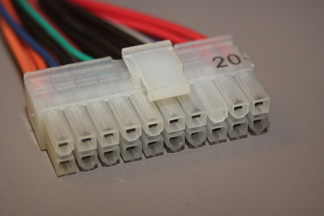
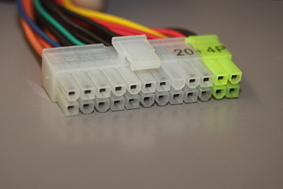
Common Power Supply Connectors
4 Pin Peripheral Power Connector
“molex connector”
SATA Power Connector
ATX 20 Pin Main Power Connector
ATX 24 Pin Main Power Connector

Slide 13
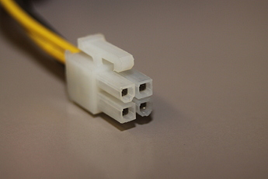
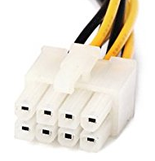
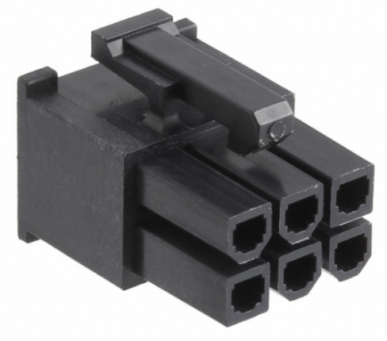
Common Power Supply Connectors
8 Pin EPS +12V Power Connector
This connector is often used to provide extra power for high-end video cards.
4 Pin ATX +12V Power Connector
6 Pin PCI Express Power Connector
Notes:
PCI Peripheral Component Interconnect/Interface (PC Bus)

Slide 14
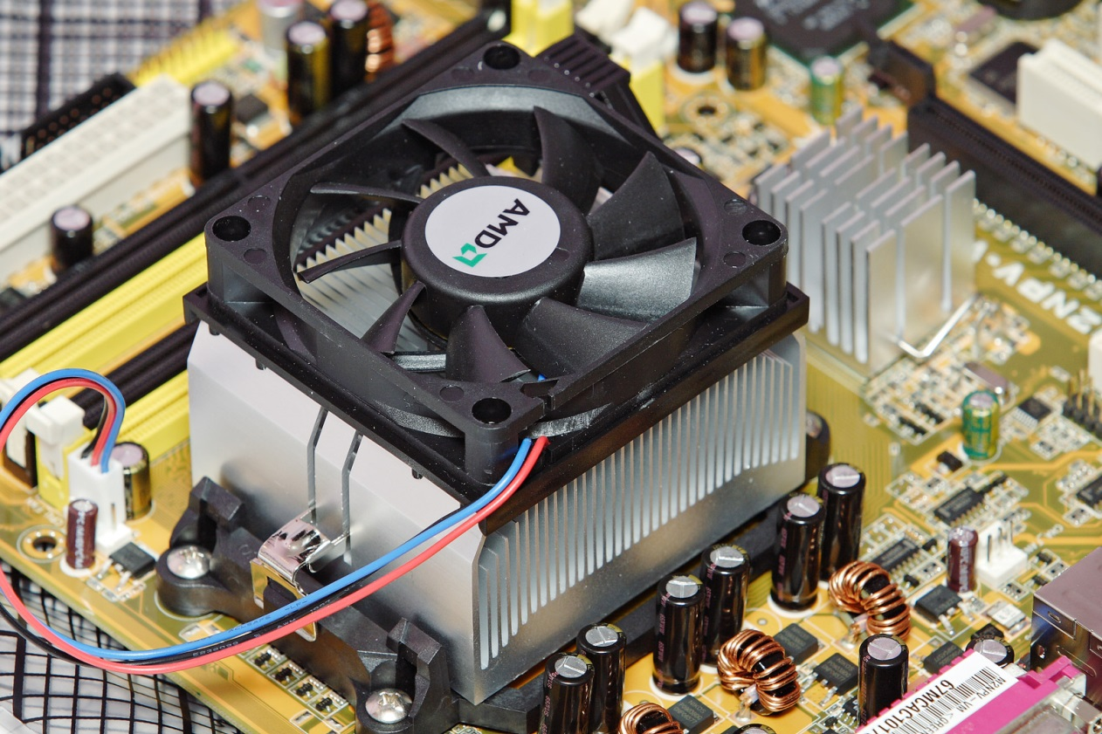
Computer Cooling
There are many ways to cool a computer.
Air Cooling uses many fans and metal heat sinks that soak up the heat, away from the delicate computer parts.

Slide 15
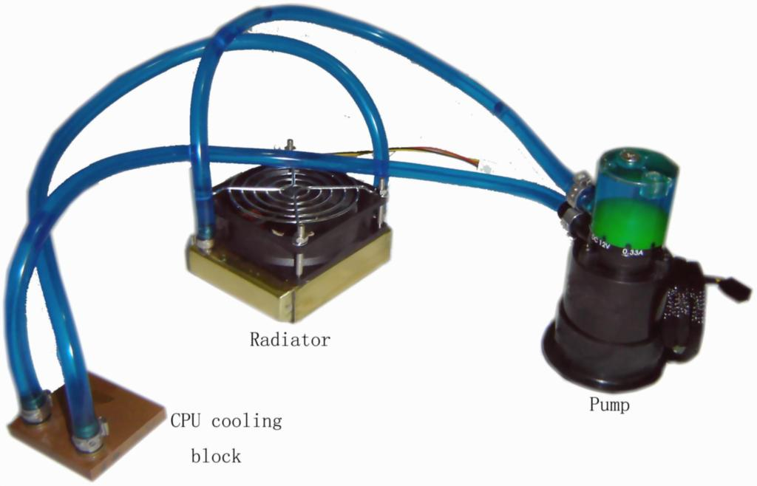
Liquid Cooling Options
Some uses decide on liquid cooling options. These options circulate water inside the computer in tubes using a pump to pull excess heat away.

Slide 16
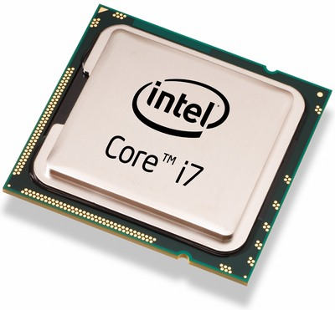
Central Processing Unit
The CPU is the hardware within a computer that carries out the instructions of a computer program by performing the basic operations of the system.

Slide 17
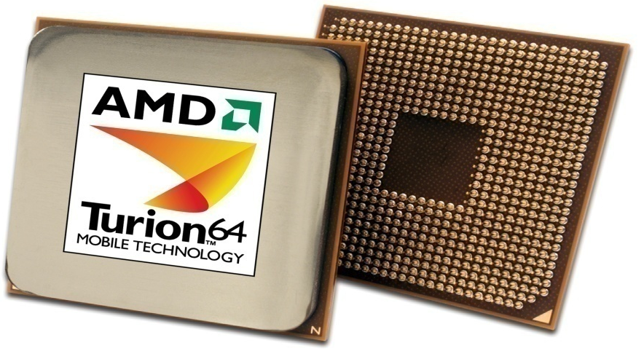
Processor
A central processing unit
An integrated circuit (IC) supplied on a single silicon chip.
It’s function is to control all the computers functions. The main processor manufacturers are:
AMD - Athlon(desktop) and Turion (laptop)
Intel - Pentium(desktop) and Centrino (mobile)
AMD
Processor

Slide 18
Volatile Memory
RAM or random access memory is the components of your computer that are used for short term storage.
Data, programs currently in use are held in RAM
Anything stored in RAM will be lost when the computer powers down.

Slide 19
Non Volatile Memory
ROM stands for Read Only Memory. The memory from which we can only read but cannot write on it. This type of memory is non-volatile. The information is stored permanently in such memories during manufacture. A ROM stores such instructions that are required to start a computer.
Contain Boot Firmware / BIOS

Slide 20
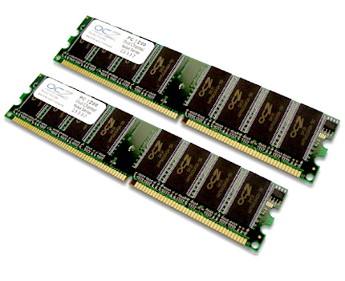
RAM Chips

Slide 21
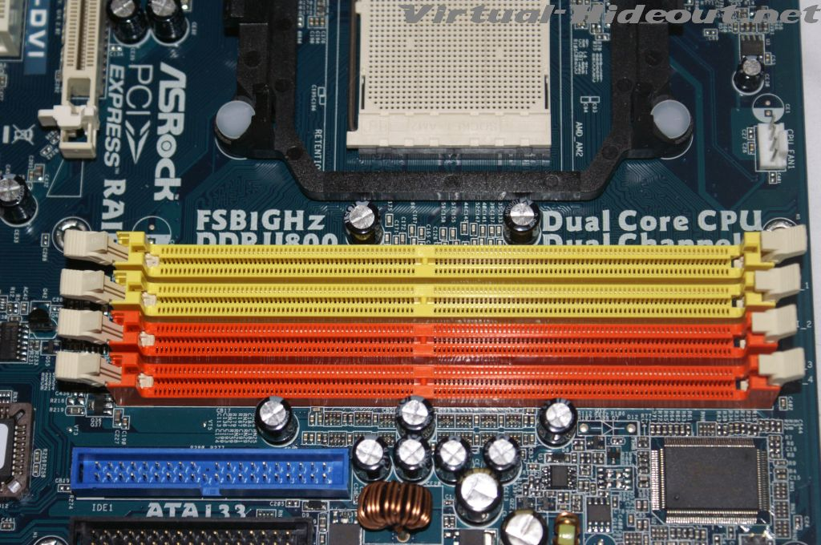
RAM Slots on the Motherboard
Not every computer has the same number of available RAM slots.

Slide 22
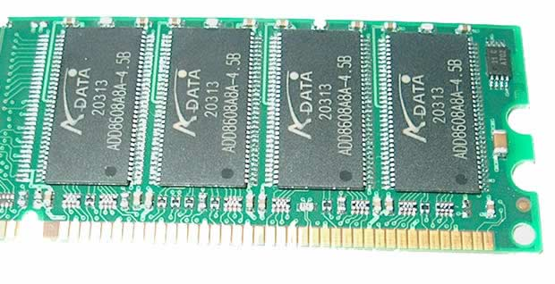
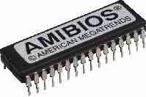
RAM
ROM

Slide 23
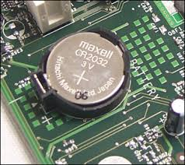
CMOS
CMOS is short for complementary metal-oxide semiconductor.
CMOS is an on-board, battery powered semiconductor chip inside computers.
CMOS generally stores date/time or BIOS passwords information.

Slide 24

Internal Storage
The Hard Disk Drive is the internal storage device used in modern computers. It connects to the motherboard by a ribbon or data cable.

Slide 25
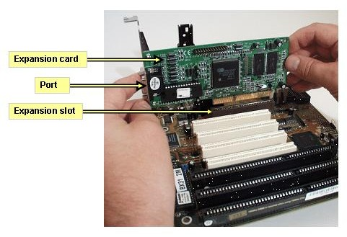
Motherboard Extra’s
On the motherboard, you will find several expansion cards. Each of these cards has a special purpose

Slide 26
Video Cards
A video card is an type of card which generates a feed of images to a monitor or display.
Cheaper computer systems may have integrated video capabilities. These built in video capabilities are less powerful than stand alone video cards.

Slide 27
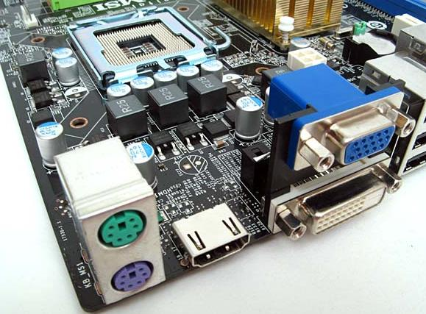
Integrated Video Cards
Notice: The Blue and White video ports are built into the motherboard

Slide 28
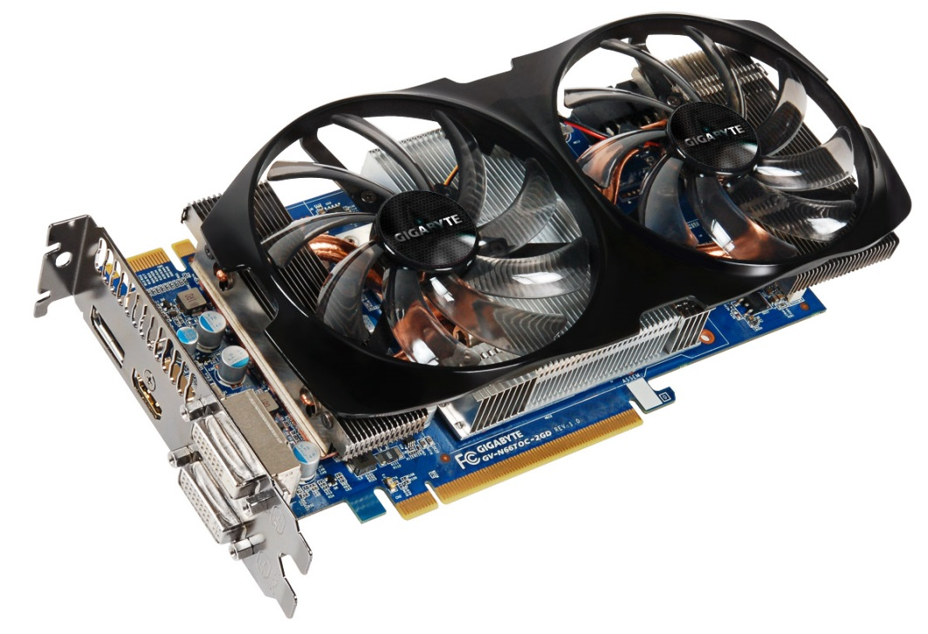
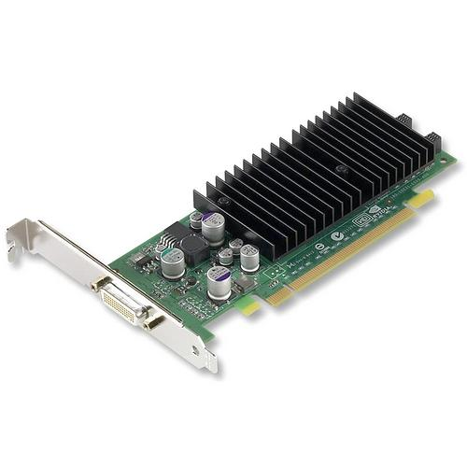
Standalone Video Cards
Low End Basic Video Card
High End Powerful Video Card

Slide 29
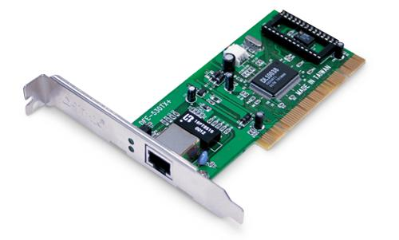
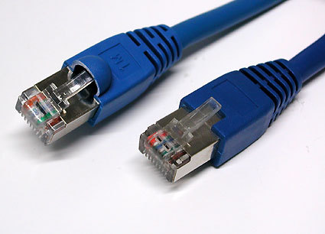
Network Cards
Most modern motherboards contain a wired internet connection point that allows the user to simply plug their computer into a network.
Some computes today still use a expansion card to connected either directly or wirelessly to a network

Slide 30
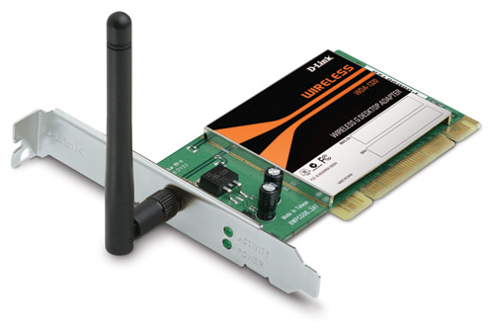
Wireless Wifi Network Card
Wired Network Card

Slide 31
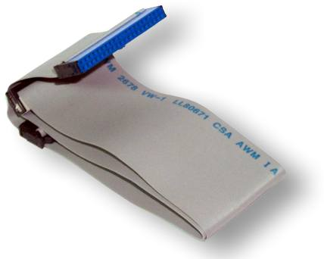
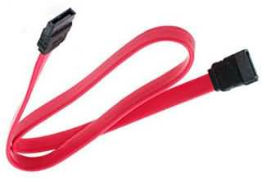
Connection Ribbon
Connection Cable

Slide 32
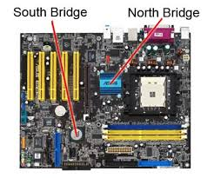
Chipset
controls data flow around the computer.
It consists of two chips:
Northbridge - data flow between memory and processor - data flow between the processor and the graphic's card
Southbridge - controls data flow to the devices - USB, IDE, SATA, LAN and Audio

Slide 33
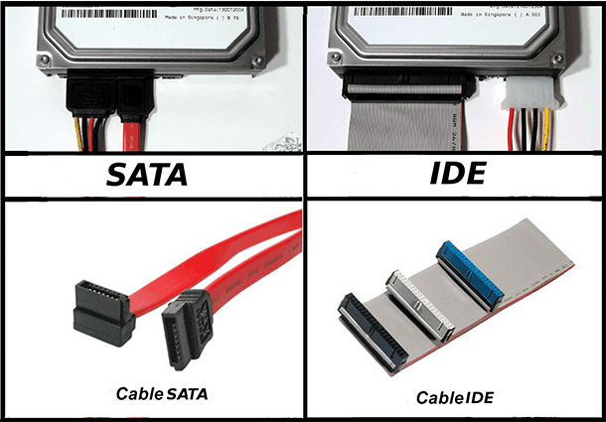
IDE , SATA and PCI
Serial Advanced technology Attachment
IDE and SATA are different types of interfaces to connect storage devices (like hard drives) to a computer's system bus.
IDE (Integrated Drive Electronics) is also called Parallel ATA or PATA.
SATA is the newer standard and SATA drives are faster than PATA (IDE) drives.

Slide 34
PCI
Peripheral Component Interconnect (PCI)
a common connection interface for attaching computer peripherals to a PC's motherboard.
used to connect sound cards and network cards.
PCI was also used to connect video cards to the motherboard, but graphics demand from gaming made it inadequate for that use
Latest version- PCIe-express

Slide 35
